Slide 1
Introduction to ARDUINO and Programming

Slide 2
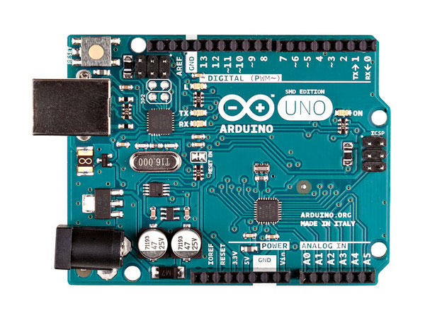
About Arduino Uno
Reset button
14 Digital I/O pins (6 PWM)
USB port
12 V input
6 Analog Input pins
3.3 V and 5 V outputs
http://www.farnell.com/datasheets/1682209.pdf

Slide 3
Setting up Arduino IDE

Slide 4
Structure of an Arduino code
1. Define Variables
Before going to the setup function constant variables should be defined
int pin = 1;
void setup()
{}
2. Setting up functions
Setup function is run once, when the microcontroller boots up or resets.
After setup function the processor moves to run code inside the loop function. Code inside loop function will be run over and over until the microcontroller is shut down.
void loop()
{}
3. Eternal loop
It’s required to have both setup() and loop() functions in the code

Slide 5
Example 1 - Blinking led
You need
Breadboard
Led
Resistor (270 ohm)
Arduino
Wires

Slide 6
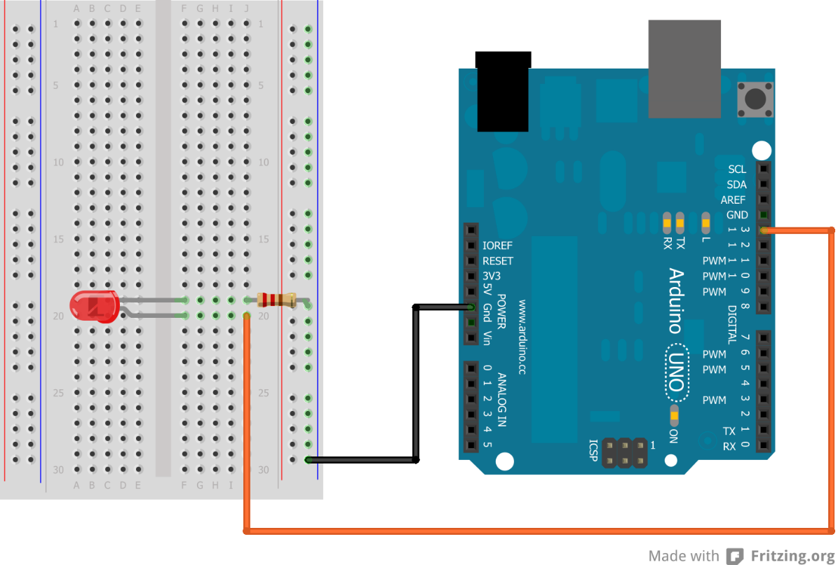
Example 1
http://blog.grifby.com/2013/04/tutorial-1-blinking-led-using-arduino.html

Slide 7
Arduino C – Basic functions
pinMode(var1, var2)
pinMode functions sets the mode of given pin. Var1 is the number of the pin and var2 is the mode (INPUT, OUTPUT)
digitalWrite(var1, var2)
digitalWrite changes the status of the pin. Var1 is the number of the pin and var2 is the status (LOW, HIGH).

Slide 8
Writing your first program
Basic blinking LED
int ledPin = 13;
void setup()
{
pinMode(ledPin, OUTPUT);
}
void loop()
{
digitalWrite(ledPin, HIGH);
delay(1000);
digitalWrite(ledPin, LOW);
delay(1000);
}

Slide 9
Writing your first program
Basic blinking LED
int ledPin = 13; //Variable to store the pin number
void setup()
{
pinMode(ledPin, OUTPUT); //set ledPin as output
}
void loop()
{
digitalWrite(ledPin, HIGH); //LED ON
delay(1000); //Wait 1000ms (=1s)
digitalWrite(ledPin, LOW); //LED OFF
delay(1000); //Wait 1000ms (=1s)
}

Slide 10
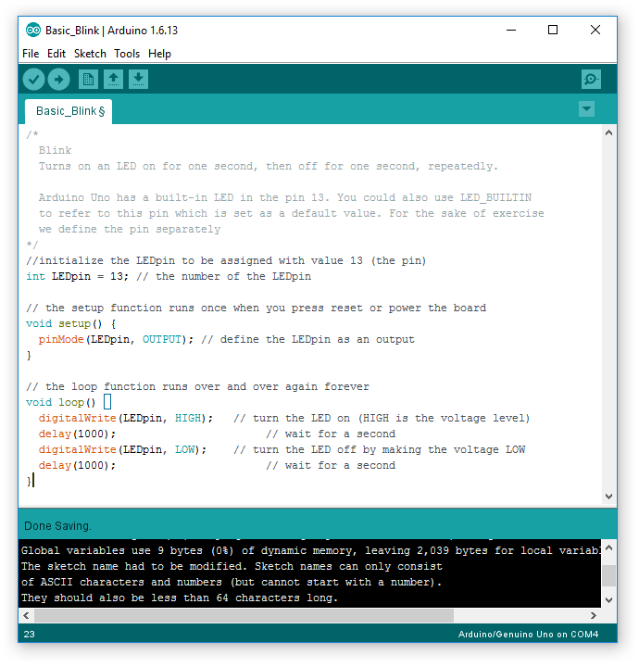
Uploading the program
Click Verify
The program is checked
Click Upload
The program is uploaded to the Arduino mCu board
2.
1.

